Slide 1
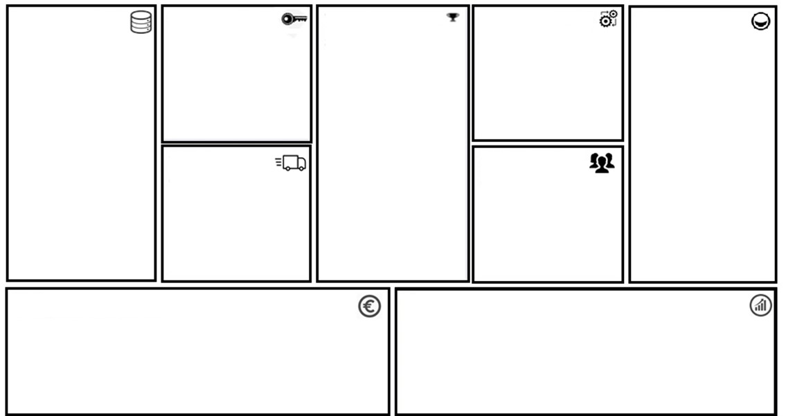
Project Canvas
More info
Data
Which data do you need?
Skills
Which skills do you need for development?
Value Proposition
What is the value added by your project?
Integration
How will the project be integrated?
Customers
Who are the end customers?
FAIR-maturity
Inidicate the FAIR-ness your
data
Output
Which key metric are
you optimizing for?
Stakeholders
Who are the key stakeholders?
Cost
What costs the project incur?
Revenue
How will the project (results) generate revenue?

